Slide 1
Self as Context as a mediator for the association between interoception and alexithymia: Implications for a Process Based Therapy
Dr. Darren Edwards

Slide 2
Mainstream definition of alexithymia
DSM – does not classify alexithymia as a mental health disorder
It is classified as a personality trait – cognitive affective components
Unsatisfactory definition

Slide 3
Advantages of process-based therapy (PBT; novel ACT approach)
New kid on the block (actually a new way of looking at therapy)
Moves away form a nomothetic paradigm (cluster/classification diagnostic approach) and toward an ideographic (individualized) approach which treats each patient as unique (patient centered)
Takes into consideration the complexity of each case rather than blanket classification based on a diagnostic protocol (e.g., the DSM)
PBT offers a framework on how to do this (more precise, specific, and contextualized) – likely to lead to greater efficacy in interventions
Explain/interpret results through a PBT lens/framework

Slide 4
Different types of therapists orientate their therapy in different ways
A CBT therapist may focus on changing cognition
Psychoanalytic therapist may focus on client’s personality and development
Behaviorist may focus on changing overt behaviour (actions) through modifying reinforcing contingencies
Thus, orientation of treatment (which dimension you focus on) may be biased by the types of therapeutic training the practitioner has received – you maybe missing on important processes dimensions

Slide 5
Can ACT process-based approaches help to focus which dimensions are important?
Deathstar project
Meta analysis of nearly 55,000 studies which explored mediators of change in psychotherapy
Underlying variance accounted by some indirect variable (the mediator)
Mediation analysis lets us know what are the underlying processes of change

Slide 6
Found that processes of change can be identified through the following dimensions
Motivation – what motivates you – (correspondence to values)
Overt behavior – our actions – (correspondence to committed action)
Sense of self – how you feel about your self, how entangled you are with defending a type of conceptualized self – (correspondence to self as context)
Attention – what you are focusing on, broad and narrow shift in focus – (correspondence to present moment awareness)
Cognition – your relationship with your thoughts – (correspondence to cognitive defusion)
Affect – how well can you regulate your emotions – (correspondence to interoceptive awareness – my own assumption)

Slide 7
The advantage of PBT over other therapeutic approaches
Enables (by providing a framework for) the therapist to take all 6 dimensions into account, allowing them to take each situation with a client from multiple angles, dynamically, without strict diagnostic – treatment framework
This gives them a better chance of finding the root cause (reinforcing loops) of what (where) the underlying problem may be
Not trying to replace one diagnostic classification with another, instead identifying useful data driven clues and novel intervention tools which may be applicable at the ideographic level, to support the dynamic PBT clinician with a patient centered approach
If the clues work (data driven), the keep them, Selection, Retention, Context (Evolutionary principles)

Slide 8
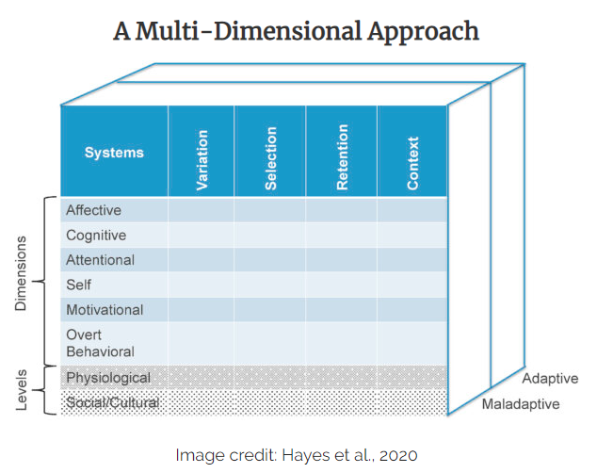
PBT is a meta-approach and gives us a holistic multidimensional perspective of mental health problems
Multi-level extended evolutionary meta-model (EEMM)

Slide 9
PBT also based on Evolutionary principles: selection of changes (what works) action
Variation – allowing client to experience changes involving emotions, thoughts, behavior (flexibility and open to these) – rigidity often associated with avoidance and distress
Selection – allowing and selecting the changes which work and discarding the rest (what brings you closer to your values)
Retention – keeping what changes works (commitment to values action)
Context – being sensitive to context when considering what change a client should take (such as being open to emotion in more supportive environments)

Slide 10
Questions: Can we build on the EEMM to develop further detail about psychophysiological processes relevant to an ideographic PBT account?
Can we use processes-based therapeutic assumptions to inform us about where important underlying processes of conditions are occurring?
Psychotherapy and biology intersect?
Can we use mediational analysis to explore specific indirect processes, to help inform us what a network may look like? -- informing an ideographic approach, building on EEMM
Can this be used to help us understand key processes for a given population condition (i.e., what key processes and dimensions may work for a given population) – which may help to inform and to focus how to develop and where to target our processed based intervention (for relevant RCT and clinical work)?
And ultimately support patient centered ideographic approaches of PBT for individuals within a specific conditional context by understating key underlying processes at a population-based level – maybe helpful to the clinician to identify important processes within a nodal network
I.e., to help us to explore network nodal diagrams of specific individual cases within a specific conditional context – hence ideographically processed based orientated and not nomothetically diagnostic classification based

Slide 11
Interested in unpacking physiology relevant to processed based psychological flexibility

Slide 12
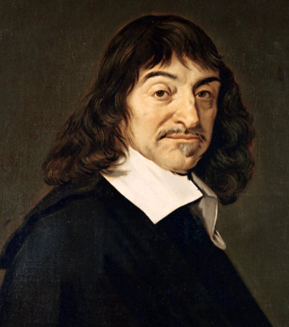
Descartes error
Descartes Mind body duality – wrong
Damasio – body and mind are integrated
Important for emotional regulation

Slide 13
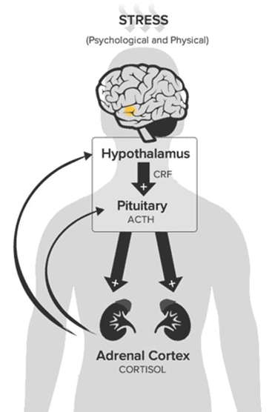
Hypothalamic pituitary axis (HPA)
Example of body and brain interacting

Slide 14
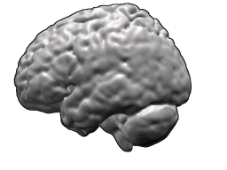
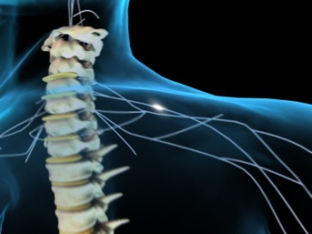
Central nervous system
Peripheral
Somatic nervous system
- movement
Autonomic nervous system
Sympathetic nervous system
Parasympathetic nervous system
Autonomous control - but does communicate with CNS
Notes:
The PNS can be divided into two connected systems:
SNS and ANS

Slide 15
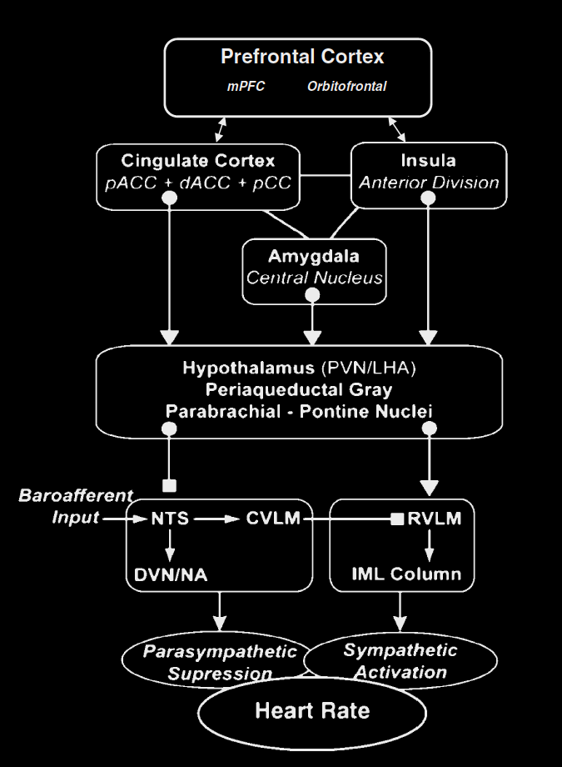
Thyer – Neurovisceral integration model

Slide 16
PBT uses network analysis
It explores how nodes in a network are connected
Each sub-problem are represented by nodes
The thought ‘I’m not good enough’ or ‘I feel lonely’ are represented on individual nodes and these are connected in a network to other nodes
We look of negative self-reinforcing loops and seek to target these with our interventions to disrupt the network the most effectively

Slide 17
Process based therapy (PBT)
The goal is to figure out which nodes and links should be targeted (negative feedback loops) to disrupt the network, to turn it from a maladaptive (encouraging avoidance) to an adaptive network which serve the client’s goals and values.

Slide 18
What is alexithymia?
Problem with labelling of ones own and other’s emotions
Somewhat different to over-selectivity in autism which is more general and goes beyond emotional labelling
Can impact on the quality of relationships one has, which then can affect the quality of life and wellbeing one experiences

Slide 19
Problems with the literature on alexithymia
Confusion about overlap with autism – problem with classification system (DSM) – need process-based approach to really understand what is going on
Specific disparate components identified – theory of mind, attention, language (labelling)
Underlying neurological processes largely unknow, assumed to involve the interoceptive pathway of the insular cortex
A need for a more holistic processed based interpretation?

Slide 20
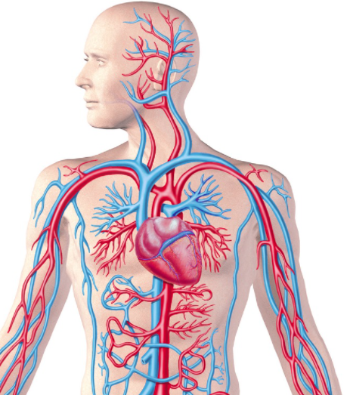
An ACT (processes based) and bodily interpretation?
Self as context vs self as content –important as deficits theory of mind comes up in the literature (lack of perspective taking)
Related to alexithymia?
Other relevant constructs?
Body? Interoceptive properties?

Slide 21
Why ACT – RFT perspective-taking – its all language!
From an RFT perspective, sense of self is a product of language within relational frames
Deictic relational responding – perspective-taking – problems with theory of mind linked with alexithymia
I vs You (interpersonal)
Here vs There (spatial)
Now vs Then (temporal)
Given alexithymia is an emotional labeling problem could this be a useful approach? -- creating perspective taking intervention for this condition may be very important

Slide 22
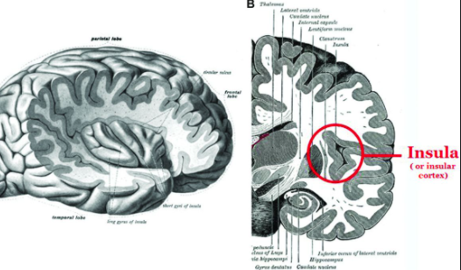
Why interoception?
Some evidence points to underlying neurological causes of the interoceptive pathway, namely the insular cortex
This pathway is responsible for components of emotional regulation and generating a meta-representation of self
i.e., a mid-level representation of self – with language added at the prefrontal cortex, this could lead to ‘selfing’ type processes as described by ACT

Slide 23
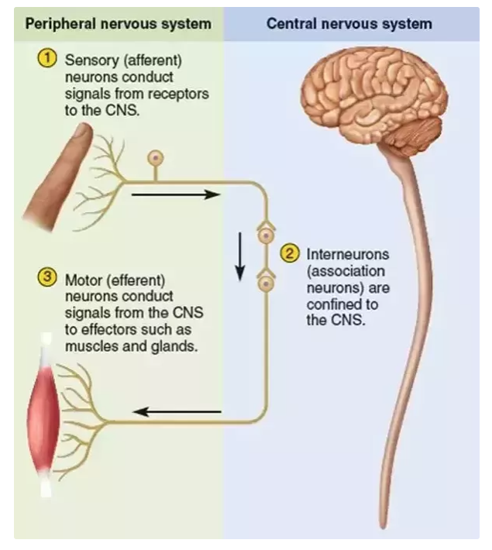
Afferents and effort neurons
Afferents incoming signals to CNS
Lamina I and II
Efferents outgoing signals from CNS to the brain

Slide 24
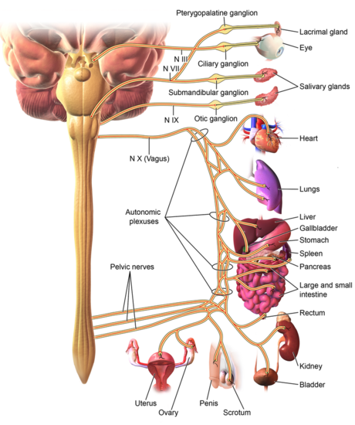
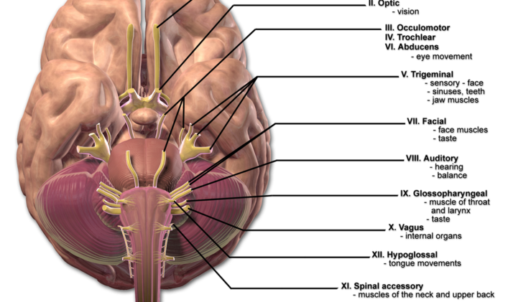
Important nerves for interoceptive signaling
Vagus nerve – Brain stem

Slide 25
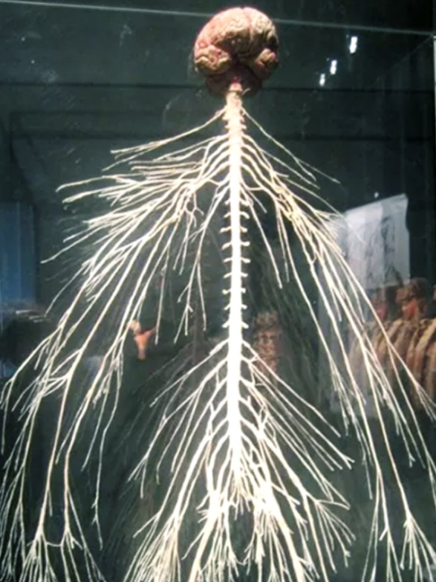
CNS and permeating nerves
This is what comprises of all our thoughts, emotions, goals, values
Skeleton just for support (hold us up)
Muscle just to move

Slide 26
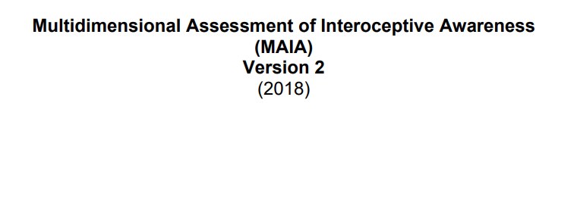
Typically use ECG – Heart beat detection task, but used questionnaire version

Slide 27
Structure of questionnaire – MAIA2

Slide 28
Examples questions 0 never, 5 Always

Slide 29
More example questions

Slide 30
High or low interoception – good or bad?
It depends – context is important
Higher interoceptive awareness often associated with positive wellbeing (affective) outcomes
Can also be associated with greater pain, and lower pain thresholds in those with some for of ongoing pain, as well as higher anxiety driven hypervigilance
Quality of interoception is important
High mindful interoceptive experience thought as positive
High anxiety driven interoceptive experience is negative

Slide 33
Mediation analysis
Typically done in RCT type studies
Mediating factor between pre and post intervention
We use these types of analysis to help us identify where to focus our interventions
What about in non-RCT studies?
Perhaps this can help us identify and look to point our RCT studies, which types of interventions to use for specific conditions

Slide 34
Self as content vs. context
Attachment to ‘who we are’ (the conceptualized self) can make us inflexible and rigid in our behavior
ACT aims to get the client in contact with self as context – letting go of the attachments of who they are (an illusion) when this is not useful
Self as context refers to an ‘I’ that is free of the content and instead is the witness to experience (the perspective-taking sense of self)

Slide 35
Selfing as a verb not a noun
I am rubbish at tennis vs. I’m having the thought that I’m rubbish at tennis

Slide 36
Self as context as a mediator - what we should expect?
Higher interoceptive (bodily) awareness (ability to perceive and experience bodily experience) = consistent with higher ability to perspective take about self and bodily experience
Higher interoceptive (bodily) awareness (ability to perceive and experience bodily experience) = consistent with greater psychological flexibility

Slide 37
Reminder:
Higher score on SAC is greater self as context
Higher score on alexithymia scale = greater alexithymia
a = Higher (emotional regulation) interoception associated with higher self as context
b = lower self as context associated with higher alexithymia
c = lower interoception associated with higher alexithymia
Crucially:
c’ = significant association between X and Y disappears as variance is (indirectly) accounted for by self as context mediator

Slide 38
Reminder:
Higher score on AAQII is greater psychological inflexibility
Higher score on alexithymia scale = greater alexithymia
a = Higher (attentional regulation) interoception associated with higher self as context
b = lower self as context associated with higher alexithymia
c = lower interoception associated with higher alexithymia
Crucially:
c’ = significant association between X and Y disappears as variance is (indirectly) accounted for by self as context mediator

Slide 39
For alexithymia, the dimension of self at the level of physiology is important to the understanding of this condition

Slide 40
Process based therapy (PBT)
Should expect to see more problems with lacking connection to self – more self as content
The goal is to figure out which nodes and links should be targeted (negative feedback loops) to disrupt the network, to turn it from a maladaptive (encouraging avoidance) to an adaptive network which serve the client’s goals and values.

Slide 41
Offers a more accurate definition of the term alexithymia through underlying processes (without classifying)
Offers an approach which may allow for more targeted perspective taking type interventions at the individual (ideographic) patient level
Enables (by providing a framework for) the therapist to take all 6 dimensions into account, allowing them to take each situation with a client from multiple angles, dynamically, without strict diagnostic – treatment framework
This gives them a better chance of finding the root cause (reinforcing loops) of what (where) the underlying problem may be
Not trying to replace one diagnostic classification with another, instead identifying useful data driven clues and novel intervention tools which may be applicable at the ideographic level, to support the dynamic PBT clinician with a patient centered approach
If the clues work (data driven), the keep them, Selection, Retention, Context (Evolutionary principles) through Extended Evolutionary Meta Model in a flexible way

Slide 42
New SAC based interventions
SAC based body scan
Promoting awareness of bodily sensations/discrimination
Promoting awareness of others bodily sensations/discrimination
Doing so in a mindful way (not anxiety driven)
Need additional RCT work to support this work
Need further ECG work to support findings
Heartbeat detection tasks

Slide 43
Thank you!! Woof Woof!!

